Slide 1
Introduction to
Database Design
July 2005
Ken Nunes
knunes @ sdsc.edu

Slide 2
Database Design Agenda
General Design Considerations
Entity-Relationship Model
Tutorial
Normalization
Star Schemas
Additional Information
Q&A
Notes:
Name and level of experience with topic.

Slide 3
General Design Considerations
Users
Legacy Systems/Data
Application Requirements
Notes:
Name and level of experience with topic.

Slide 4
Users
Who are they?
  Administrative
  Scientific
  Technical
Impact
  Access Controls
  Interfaces
  Service levels
Notes:
Entities denote people, places, things, or event of informational interest. Nouns. Entities should contain descriptive information.

Slide 5
Legacy Systems/Data
What systems are currently in place?
Where does the data come from?
How is it generated?
What format is it in?
What is the data used for?
Which parts of the system must remain static?

Slide 6
Application Requirements
What kind of database?
  OnLine Analytical Processing (OLAP)
  OnLine Transactional Processing (OLTP)
Budget
Platform / Vendor
Workflow?
  order of operations
  error handling
  reporting

Slide 7
Entity - Relationship Model
A logical design method which emphasizes simplicity and readability.
Basic objects of the model are:
  Entities
  Relationships
  Attributes

Slide 8
Entities
Data objects detailed by the information in the database.
  Denoted by rectangles in the model.
Employee
Department
Notes:
Entities denote people, places, things, or event of informational interest. Nouns. Entities should contain descriptive information.

Slide 9
Attributes
Characteristics of entities or relationships.
  Denoted by ellipses in the model.
Employee
Department
Name
SSN
Name
Budget
Notes:
Provide details about the entities, Entity of person, attribute is name, hair color

Slide 10
Relationships
Represent associations between entities.
  Denoted by diamonds in the model.
Employee
works in
Department
Name
SSN
Start date
Name
Budget

Slide 11
Relationship Connectivity
Constraints on the mapping of the associated entities in the relationship.
  Denoted by variables between the related entities.
  Generally, values for connectivity are expressed as “one” or “many”
Employee
N
work
1
Department
Name
SSN
Start date
Name
Budget
Notes:
Each department can have multiple employees.

Slide 12
Connectivity
one-to-one
Department
1
has
1
Manager
one-to-many
Department
1
has
N
Project
many-to-many
Employee
M
works on
N
Project
Notes:
Each department can have multiple employees.

Slide 13
ER example
Volleyball coach needs to collect information about his team.
The coach requires information on:
  Players
  Player statistics
  Games
  Sales

Slide 14
Team Entities & Attributes
Players - statistics, name, start date, end date
Games - date, opponent, result
Sales - date, tickets, merchandise
Name
Statistics
Games
Players
Sales
date
opponent
result
tickets
merchandise
Start date
End date

Slide 15
Team Relationships
Identify the relationships.
The player statistics are recorded at each game so the player and game entities are related.
  For each game, we have multiple players so the relationship is one-to-many
1
N
Games
Players
play

Slide 16
Team Relationships
Identify the relationships.
The sales are generated at each game so the sales and games are related.
  We have only 1 set of sales numbers for each game, one-to-one.
1
1
Games
generates
Sales

Slide 17
Team ER Diagram
date
opponent
result
Games
1
1
play
generates
N
1
Players
Sales
Name
Start date
End date
Statistics
tickets
merchandise

Slide 18
Logical Design to Physical Design
Creating relational SQL schemas from entity-relationship models.
  Transform each entity into a table with the key and its attributes.
  Transform each relationship as either a relationship table (many-to-many) or a “foreign key” (one-to-many and many-to-many).
Notes:
Provide details about the entities, Entity of person, attribute is name, hair color

Slide 19
Entity tables
Transform each entity into a table with a key and its attributes.
Employee
create table employee
(emp_no number,
name varchar2(256),
ssn number,
primary key (emp_no));
Name
SSN
Notes:
Provide details about the entities, Entity of person, attribute is name, hair color

Slide 20
Foreign Keys
Transform each one-to-one or one-to-many relationship as a “foreign key”.
  Foreign key is a reference in the child (many) table to the primary key of the parent (one) table.
Department
create table department
(dept_no number,
name varchar2(50),
primary key (dept_no));
1
has
create table employee
(emp_no number,
dept_no number,
name varchar2(256),
ssn number,
primary key (emp_no),
foreign key (dept_no) references department);
N
Employee
Notes:
Provide details about the entities, Entity of person, attribute is name, hair color

Slide 21
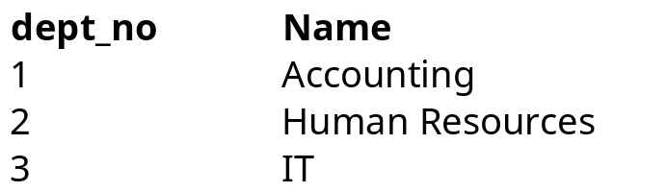
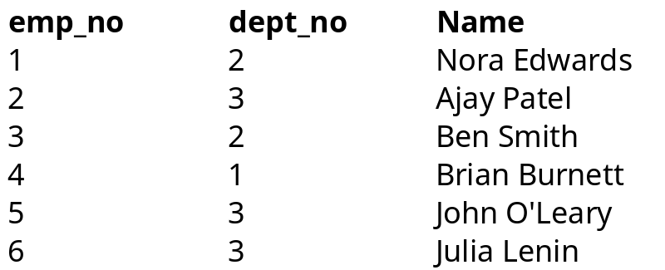
Foreign Key
Department
Accounting has 1 employee:
Brian Burnett
Human Resources has 2 employees:
Nora Edwards
Ben Smith
IT has 3 employees:
Ajay Patel
John O’Leary
Julia Lenin
Employee

Slide 22
Many-to-Many tables
Transform each many-to-many relationship as a table.
  The relationship table will contain the foreign keys to the related entities as well as any relationship attributes.
Project
create table proj_has_emp
(proj_no number,
emp_no number,
start_date date,
primary key (proj_no, emp_no),
foreign key (proj_no) references project
foreign key (emp_no) references employee);
N
Start date
has
M
Employee
Notes:
Provide details about the entities, Entity of person, attribute is name, hair color

Slide 23
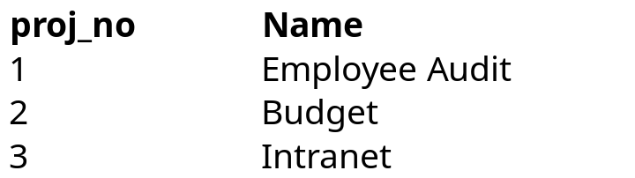
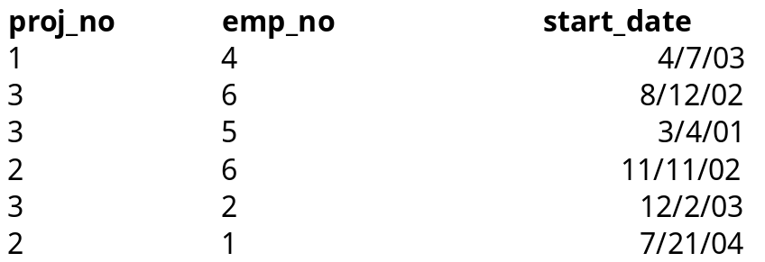
Many-to-Many tables
Project
proj_has_emp
Employee
Employee Audit has 1 employee:
Brian Burnett
Budget has 2 employees:
Julia Lenin
Nora Edwards
Intranet has 3 employees:
Julia Lenin
John O’Leary
Ajay Patel

Slide 24
Tutorial
Entering the physical design into the database.
Log on to the system using SSH.
  % ssh user@ds003.sdsc.edu
Setup the database instance environment:
  (csh or tcsh)
  % source /dbms/db2/home/db2i010/sqllib/db2cshrc
  (sh, ksh, or bash)
  $ . /dbms/db2/home/db2i010/sqllib/db2cshrc
Run the DB2 command line processor (CLP)
  % db2
Notes:
Teragrid:
ssh user@tg-login.sdsc.teragrid.org
Echo $DB2INSTANCE -> null then run: soft add +db2
db2

Slide 25
Tutorial
db2 prompt will appear following version information.
  db2=>
connect to the workshop database:
  db2=> connect to workshop
create the department table
  db2=> create table department \
  db2 (cont.) => (dept_no smallint not null, \
  db2 (cont.) => name varchar(50), \
  db2 (cont.) => primary key (dept_no))
Notes:
List database directory
Get authorizations
List tables for schema <user>

Slide 26
Tutorial
create the employee table
  db2 => create table employee \
  db2 (cont.) => (emp_no smallint not null, \
  db2 (cont.) => dept_no smallint not null, \
  db2 (cont.) => name varchar(50), \
  db2 (cont.) => ssn int not null, \
  db2 (cont.) => primary key (emp_no), \
  db2 (cont.) => foreign key (dept_no) references department)
list the tables
  db2 => list tables for schema <user>
Notes:
List database directory
Get authorizations
List tables for schema <user>

Slide 27
Normalization
A logical design method which minimizes data redundancy and reduces design flaws.
Consists of applying various “normal” forms to the database design.
The normal forms break down large tables into smaller subsets.
Notes:
Accomplish normalization by analyzing the interdependencies among attributes in tables and taking subsets of larger tables to form smaller ones.
The subsets are created from examining the interdependencies among the table attributes.

Slide 28
First Normal Form (1NF)
Each attribute must be atomic
  No repeating columns within a row.
  No multi-valued columns.
1NF simplifies attributes
  Queries become easier.

Slide 29
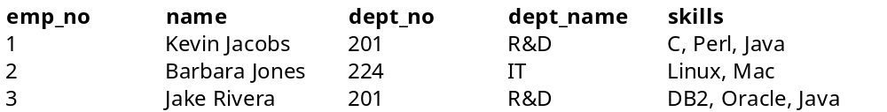
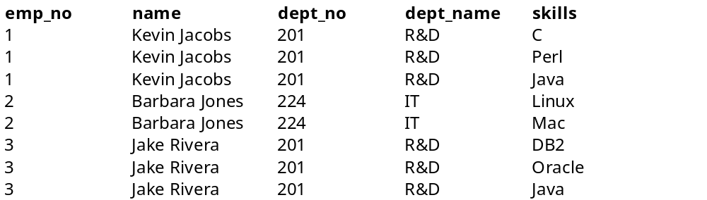
1NF
Employee (unnormalized)
Employee (1NF)

Slide 30
Second Normal Form (2NF)
Each attribute must be functionally dependent on the primary key.
  Functional dependence - the property of one or more attributes that uniquely determines the value of other attributes.
  Any non-dependent attributes are moved into a smaller (subset) table.
2NF improves data integrity.
  Prevents update, insert, and delete anomalies.

Slide 31
Functional Dependence
Employee (1NF)
Name, dept_no, and dept_name are functionally dependent on emp_no. (emp_no -> name, dept_no, dept_name)
Skills is not functionally dependent on emp_no since it is not unique to each emp_no.

Slide 32
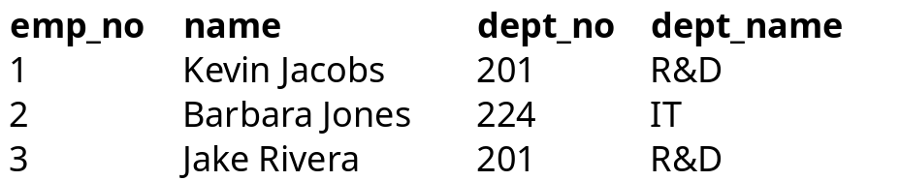
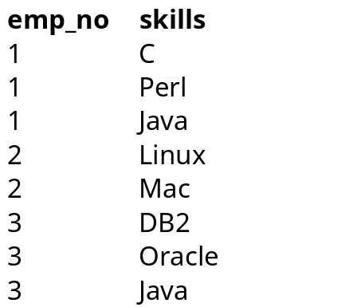
2NF
Employee (1NF)
Employee (2NF)
Skills (2NF)

Slide 33
Data Integrity
Employee (1NF)
Insert Anomaly - adding null values. eg, inserting a new department does not require the primary key of emp_no to be added.
Update Anomaly - multiple updates for a single name change, causes performance degradation. eg, changing IT dept_name to IS
Delete Anomaly - deleting wanted information. eg, deleting the IT department removes employee Barbara Jones from the database

Slide 34
Third Normal Form (3NF)
Remove transitive dependencies.
  Transitive dependence - two separate entities exist within one table.
  Any transitive dependencies are moved into a smaller (subset) table.
3NF further improves data integrity.
  Prevents update, insert, and delete anomalies.

Slide 35
Transitive Dependence
Employee (2NF)
Dept_no and dept_name are functionally dependent on emp_no however, department can be considered a separate entity.
Notes:
Note, dept_name is functionally dependent on dept_no. Dept_no is functionally dependent on emp_no, so via the middle step of dept_no, dept_name is functionally dependent on emp_no.
(emp_no -> dept_no , dept_no -> dept_name, thus emp_no -> dept_name)

Slide 36
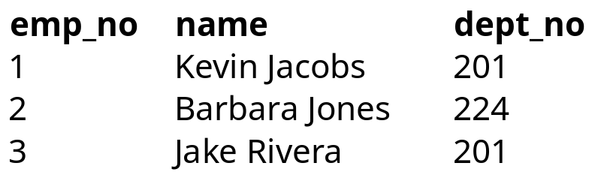
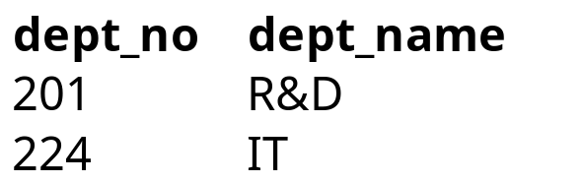
3NF
Employee (2NF)
Employee (3NF)
Department (3NF)

Slide 37
Other Normal Forms
Boyce-Codd Normal Form (BCNF)
  Strengthens 3NF by requiring the keys in the functional dependencies to be superkeys (a column or columns that uniquely identify a row)
Fourth Normal Form (4NF)
  Eliminate trivial multivalued dependencies.
Fifth Normal Form (5NF)
  Eliminate dependencies not determined by keys.

Slide 38
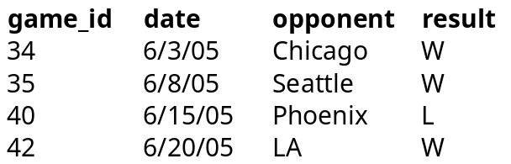
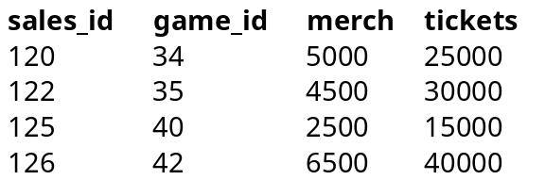
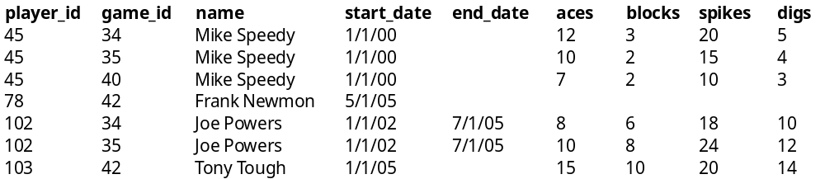
Normalizing our team (1NF)
games
sales
players

Slide 39
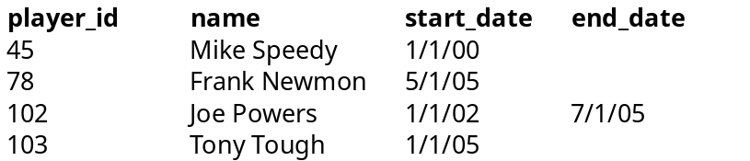
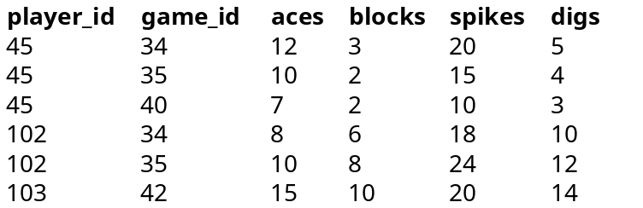
Normalizing our team (2NF & 3NF)
games
sales
players
player_stats

Slide 40
Revisit team ER diagram
date
opponent
result
1
1
games
generates
sales
1
Recorded by
tickets
merchandise
N
player_stats
tracked
players
N
1
aces
blocks
digs
spikes
Name
Start date
End date

Slide 41
Star Schemas
Designed for data retrieval
  Best for use in decision support tasks such as Data Warehouses and Data Marts.
  Denormalized - allows for faster querying due to less joins.
  Slow performance for insert, delete, and update transactions.
  Comprised of two types tables: facts and dimensions.

Slide 42
Fact Table
The main table in a star schema is the Fact table.
  Contains groupings of measures of an event to be analyzed.
    Measure - numeric data
Invoice Facts
units sold
unit amount
total sale price

Slide 43
Dimension Table
Dimension tables are groupings of descriptors and measures of the fact.
    descriptor - non-numeric data
Customer Dimension
Time Dimension
cust_dim_key
name
address
phone
time_dim_key
invoice date
due date
delivered date
Location Dimension
Product Dimension
loc_dim_key
store number
store address
store phone
prod_dim_key
product
price
cost

Slide 44
Star Schema
The fact table forms a one to many relationship with each dimension table.
Customer Dimension
Time Dimension
cust_dim_key
name
address
phone
1
1
Invoice Facts
time_dim_key
invoice date
due date
delivered date
N
N
cust_dim_key
loc_dim_key
time_dim_key
prod_dim_key
units sold
unit amount
total sale price
Product Dimension
Location Dimension
N
prod_dim_key
product
price
cost
loc_dim_key
store number
store address
store phone
1
N
1
Notes:
which provides an intuitive schema for querying information.

Slide 45
Analyzing the team
The coach needs to analyze how the team generates income.
  From this we will use the sales table to create our fact table.
Team Facts
date
merchandise
tickets

Slide 46
Team Dimension
We have 2 dimensions for the schema:
player and games.
Game Dimension
Player Dimension
game_dim_key
opponent
result
player_dim_key
name
start_date
end_date
aces
blocks
spikes
digs

Slide 47
Team Star Schema
Team Facts
player_dim_key
game_dim_key
date
merchandise
tickets
N
N
Player Dimension
1
player_dim_key
name
start_date
end_date
aces
blocks
spikes
digs
Game Dimension
1
game_dim_key
opponent
result

Slide 48
Books and Reference
Database Design for Mere Mortals,
  Michael J. Hernandez
Information Modeling and Relational Databases,
  Terry Halpin
Database Modeling and Design,
  Toby J. Teorey

Slide 49
Continuing Education
UCSD Extension
    Data Management Courses
    DBA Certificate Program
    Database Application Developer Certificate Program

Slide 50
Data Central
The Data Services Group provides Data Allocations for the scientific community.
  http://datacentral.sdsc.edu/
  Tools and expertise for making data collections available to the broader scientific community.
  Provide disk, tape, and database storage resources.

